Slide 1
Virtual Doctor: A System for Human Health. (Requirement Analysis) Presented By: Protiva Arafin (18201011) Mir Arnab Kabir (18201018) Aiatul Al-Amin Ador (18201019)

Slide 2
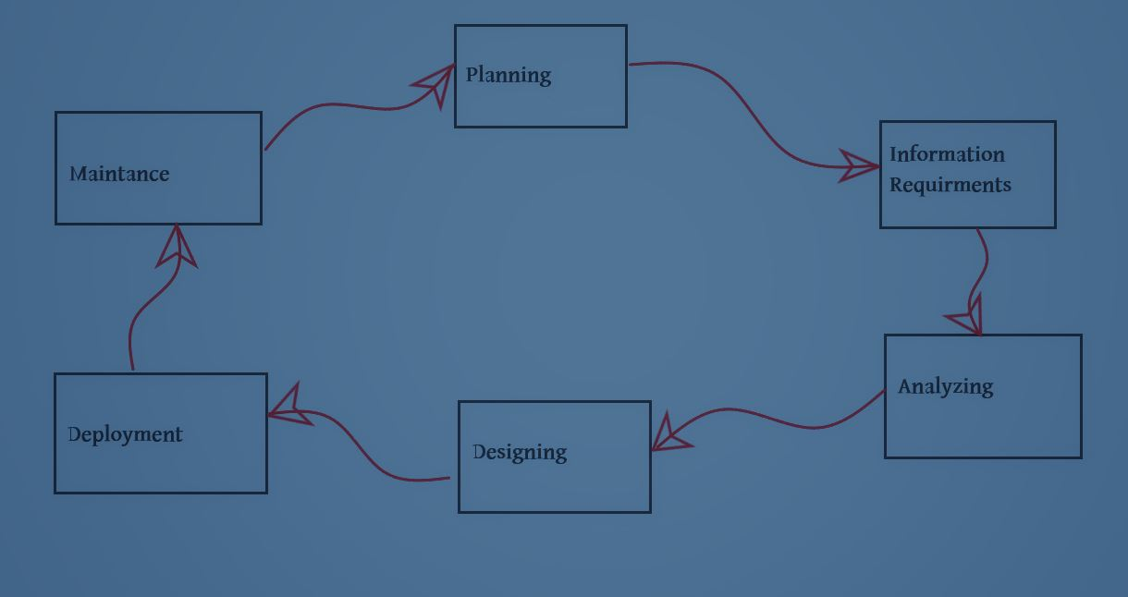
SDLC Life Cycle & Phases:

Slide 3
Analyzing Requirements: The main aim of this phase is to collect the details of each requirement of the customers so that the developers will clearly understand what they are developing. And determining whether the stated requirements are unclear, incomplete, ambiguous, or contradictory, and then resolving these issues.
User Requirements:
1.People never know when any injury may happen to them. Thus it is always good to have emergency backup. They need immediate first aid treatment.
2.If first aid treatment doesn’t work then people need instant information about nearby hospitals.
3.Sometimes transportation is a huge problem in our country. So they need ambulance without any delay
4.Organized information is the best thing to find out something instantly. People need the best doctor available in their area for their specific problems.

Slide 4

Purpose of this System:
So as per the requirements we are going to build an app-based system and the main target is First aid treatment. When someone use it, this system will help people by asking different types of question and will try to prescribe a first aide type solution. Also, the GPS will locate the patients location and if needed then show him the nearest hospital or call an Ambulance. Also, this system will help people to find who is the best doctor available in his area for his specific problem.

Slide 5

Feasibility Analysis: It is one of the major Phase of SDLC in which an organization discusses about the cost and benefits of the software or System. Its also call decision making phase. Because profit from the system plays on important role if cost is very high then the company may face less.
After the feasibility Studies-
I. The project may be accepted with some modification.
II. Rejected

Slide 6
Economic Feasibility: Economic feasibility is determined by identifying costs and benefits associated with the system, assigning values to them, calculating future cash flows, ROI, BEP and measuring the financial worthiness of the project. There is two method to do that.
For our system, We will use Simple Cash Flow Method.

Slide 7
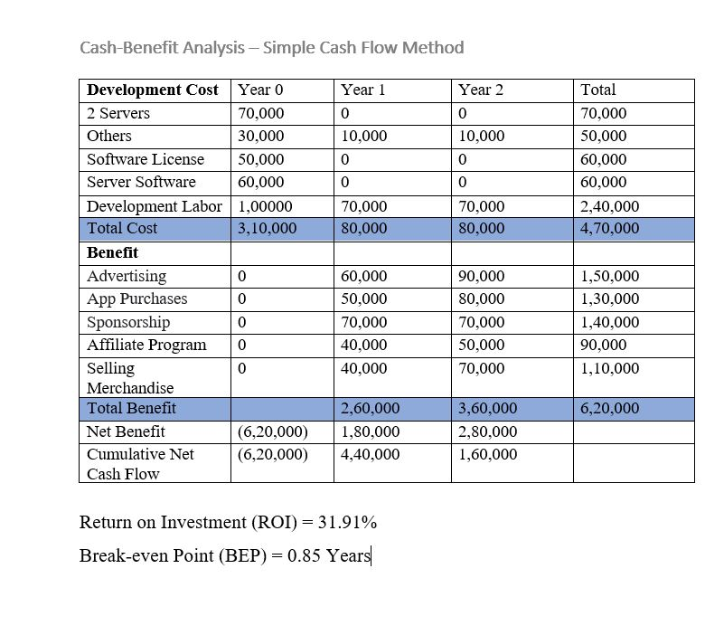
From, This analysis,
Acceptable ROI
Benefit starts from the First year.
So, Economically Acceptable Project.

Slide 8
Technical Feasibility Analysis: A technical feasibility study assesses the details of how we intend to deliver a product or service to customers.
<>Source Of Risk:
Users have a lack of familiarity with our system?
Whether the treatment that doctors will give to patients will be right?
Will user data safe with us?

Slide 9
Organizational Feasibility: Organizational feasibility shows that how well the system ultimately will be accepted by its users and incorporated into the ongoing operations of the organization.
<>If we will build it will they come?
Our system will be one of the most efficient system available on the market.
People from remote areas will be able to get the essential service at home without coming to the city at low costs.

Slide 10
Conclusion

Slide 11
Thank You.

